Slide 1

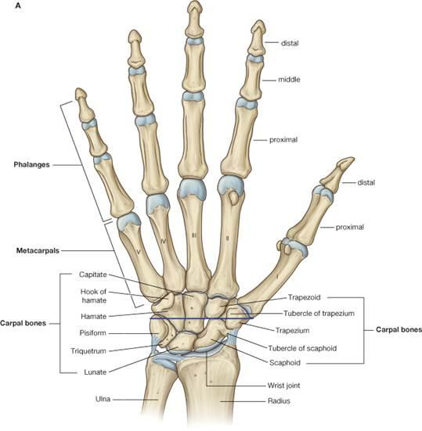
Near Middle F. J.
8
Far Middle Finger Joint
Near Ring Finger Joint
11
Middle Middle F. J.
10
7
Near Index Finger Joint
Middle Ring Finger Joint
9
12
Far Ring Finger Joint
6
Middle Index Finger Joint
13
Near Pinky Finger Joint
14
5
Far Index Finger Joint
Middle Pinky Finger Joint
15
4
Near Thumb Joint
16
3
Far Thumb Joint
Far Pinky Finger Joint
2
Center of Paw
1
Center of Pellet
The far/middle/near designation was conceived in reference to the center frame, i.e. the farthest joint from the view of the person marking

